Slide 1
Python based Back-Propagation Neural Network for Automatic Speech Recognition

Slide 2
Presented by: Likhit Teja 2015A3PS0221P Shikhar Shiromani 2015A3PS0194P Pratyush Priyank 2015A3PS0188P
Link to the paper:
http://www.rroij.com/open-access/matlab-based-backpropagation-neuralnetwork-for-automatic-speech-recognition.php?aid=44466

Slide 3
Contribution of each member:
Likhit and Shikhar: Writing and testing the code and tuning the parameters
Pratyush: Data set collection, Speech Feature Analysis

Slide 4
Work done
The paper implements a Back-Propagation Neural Network for automatic speech recognition. The recordings used for the project are single digit numbers (0-9) and the features have been obtained using MFCC (Mel Frequency Cepstral Coefficients) and Dimensionality Reduction has been done using SVD (Singular Value Decomposition ).

Slide 5
Work done (Contd.)
The following are the parameters/hyper-parameters used in the paper, which we initially implemented:
No. of hidden layers: 1
No. of input neurons: 13
No. of neurons in hidden layer: 11
No. of output neurons: 10 (since 10 numbers need to be classified)
Weights: randomly initialised between -0.5 and 0.5
Learning rate: 0.5
Momentum: 0.2

Slide 6
Work done (Contd.)
No. of epochs: 1000
Activation function: Sigmoid (both hidden and output layers)
Cost function: Mean Square Error
Training Data
The paper used 50 single digit recordings,
out of which 20 were used for training.

Slide 7
Flowcharts
Input Audio Signal
Feature extraction using MFCC
Dimensionality Reduction using SVD

Slide 8
Flowcharts (Contd.)
Input to Neural Network
Training the Neural Network to minimise cost
Choosing optimal parameters/hyper-parameters

Slide 9
Flowcharts (Contd.)
Testing the accuracy on training set
Testing the accuracy on test set

Slide 10
Sources of Data
Spoken Digit Dataset ( 3 people):
https://github.com/Jakobovski/free-spoken-digit-dataset
Also recorded with our friends
Speech Feature Extraction :
Python_speech_features library
https://github.com/jameslyons/python_speech_features

Slide 11
Software/framework used
Python
Jupyter Notebooks

Slide 12
Paper implementation
The paper was successfully implemented with a few changes.

Slide 13
Snapshots of code

Slide 14
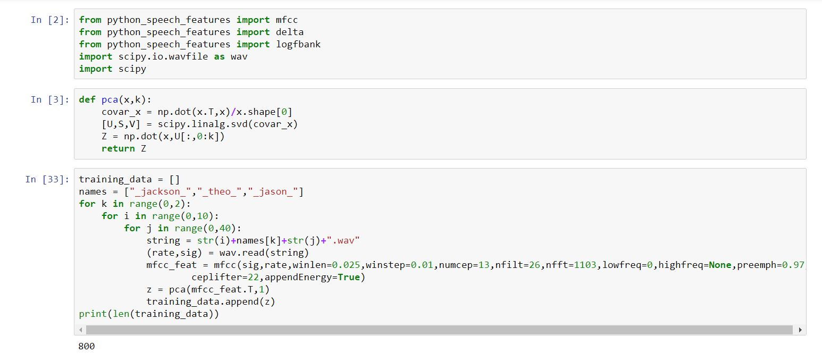

Slide 15
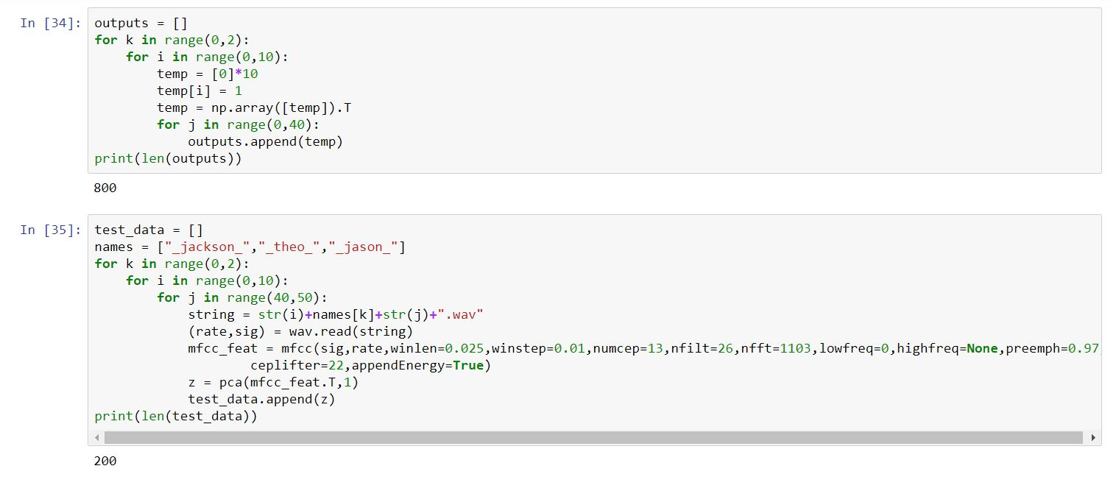

Slide 16
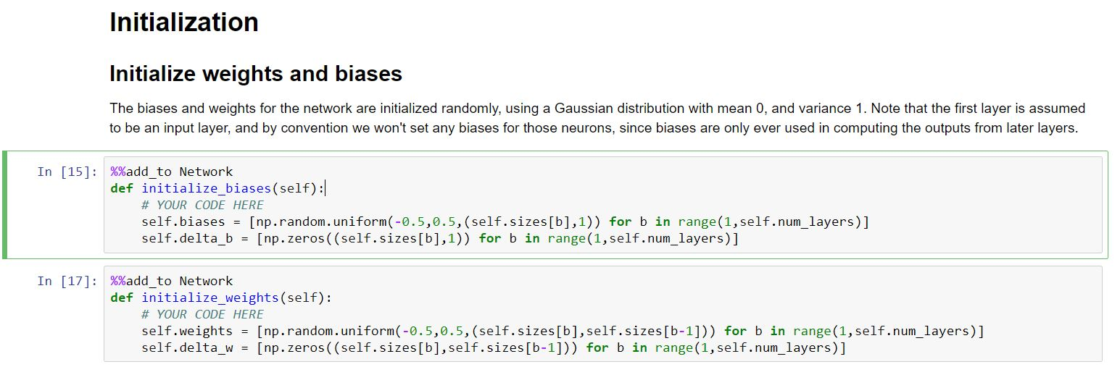

Slide 17
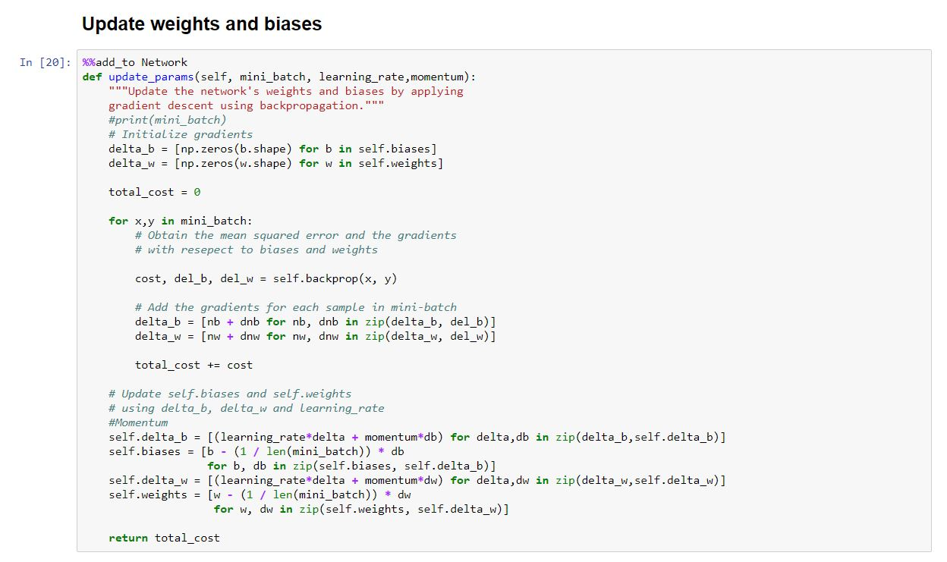

Slide 18
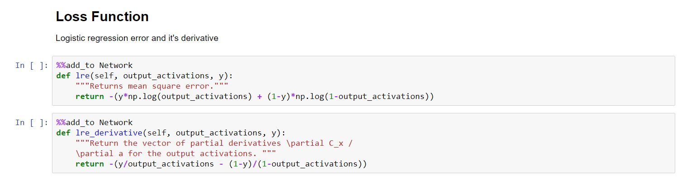

Slide 19
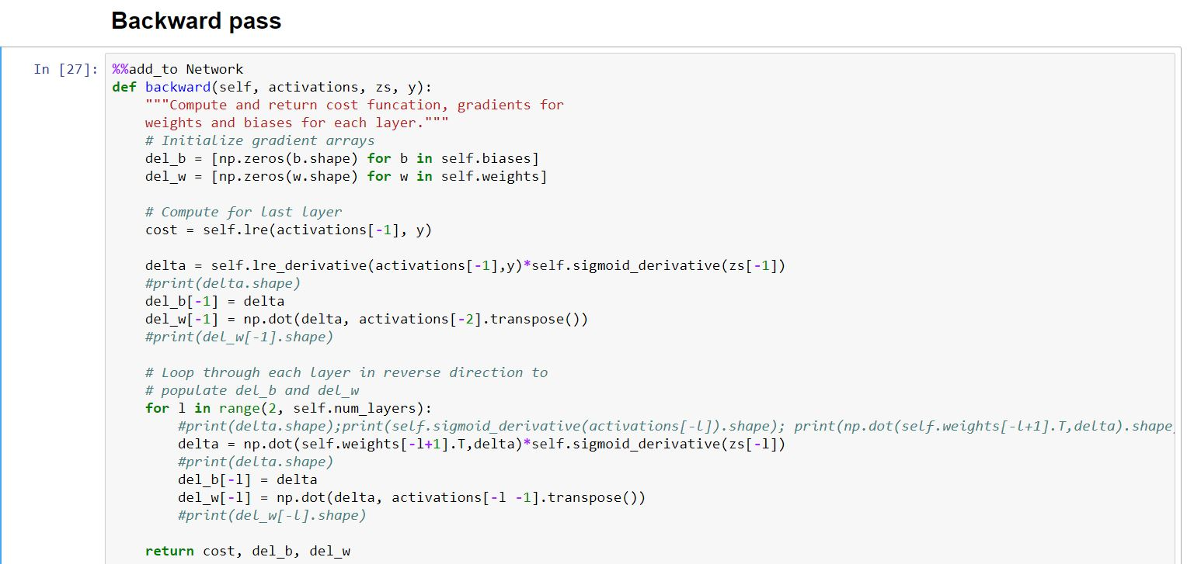

Slide 20
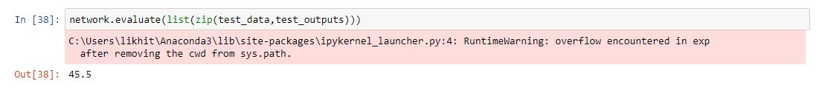

Slide 21
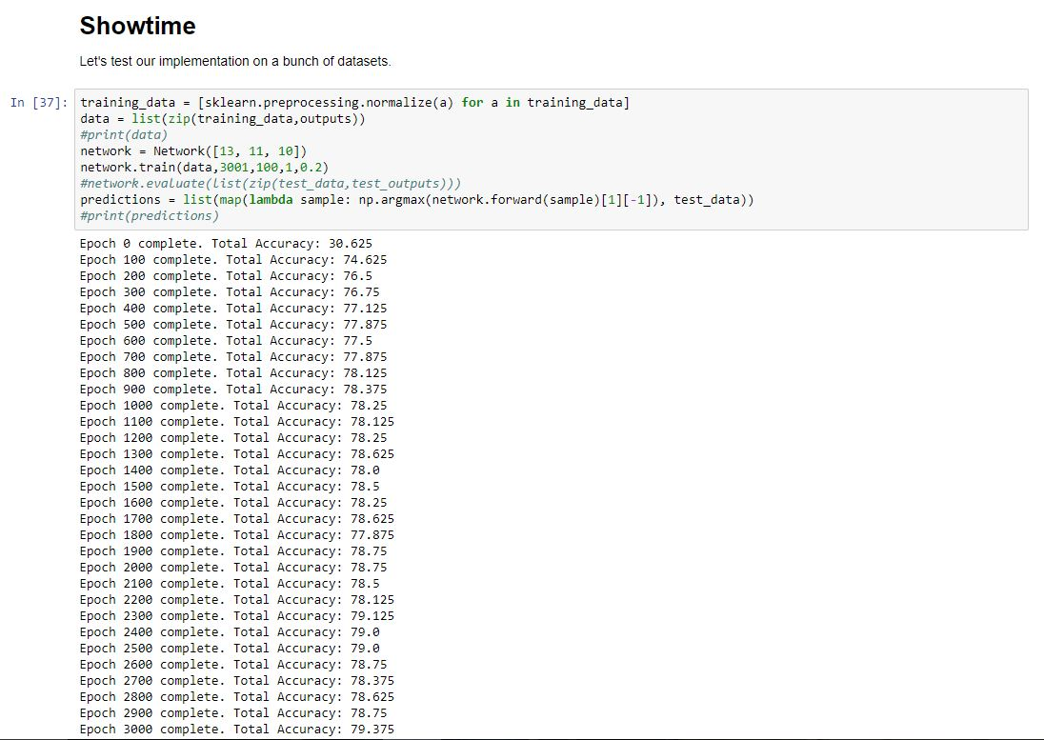

Slide 22
Results
Training accuracy of around 80% was achieved.
A maximum evaluation accuracy of around 47% was achieved.

Slide 23
Improvisations
Logistic Regression cost function has been used instead of Mean Square Error, for minimizing the cost function
Principal Component Analysis has been used for getting a 13*1 vector
A more robust data set has been used to make a more generalized classification. Around 1500 audio samples of 3 different speakers were divided appropriately into training and test sets to achieve the same
3000 Epochs have been used and learning rate has been set to 1

Slide 24
Conclusion& Recommendations
More hidden layers can be used
Different activation functions can be tried, like ReLU
More varied data set can be used to identify more speakers
The digit recognition can be extended to speech recognition in general

Slide 25
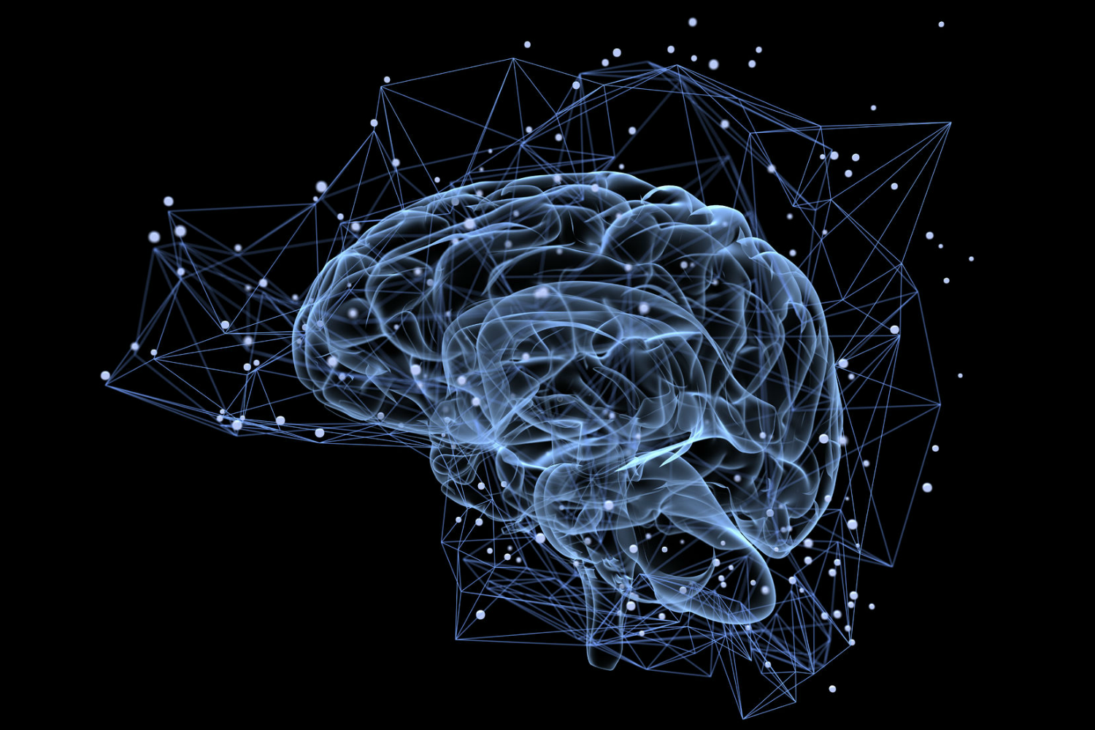
THANK
YOU

